Slide 1



Welcome you all
Course: HTML
Day 2
D.Sakthivel
Assistant Professor & Trainer,
KG Micro College
KGiSL Campus, Coimbatore – 641 035.

Slide 2

Content:
What does HTML 5 do?
Comparison Table Between HTML 4 and HTML 5
HTML 5 version tags
Semantics
The Description Term element
Table
Summary
Ordered and Unordered list
Hyperlink

Slide 3
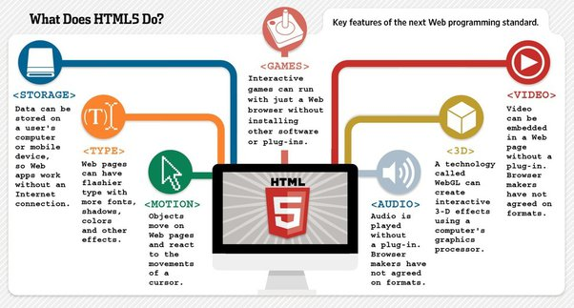
<title>

Slide 4
Comparison Table Between HTML 4 and HTML 5
Parameters of Comparison | HTML 4 | HTML 5
Version | HTML 4 is the 4th version of HTML and is also the extended version of HTML 3.2 | HTML 5 is the 5th version of HTML and is also the extension of HTML 4
Features | It is an older version and so it has fewer features | It is a new version and has advanced features
Error handling | It provides decent error handling and moderate consistency in malformed documents | It provides better error handling and has high consistency in malformed documents
Third-party elements | HTML 4 is supported by many third-party elements like Silverlight and flash | HTML 5 is supported by multimedia
Tags Provision | There is no provision for new tags in HTML 4 | It allows new tags like video, canvas, audio and others
<body>
The body contains the actual content of the page. Everything that is contained in the body is visible to the user. It has attributes like bgcolor, background image.
Syntax:
<body> your content goes here </body>

Slide 5

Some of the tags and attributes used in the earlier versions of HTML can also be used in HTML5.
TAGS | ATTRIBUTES | EXAMPLES
<BODY> | bgcolor=“any colour” Sets the background colour of the webpage. background=“any picture file” text=“any color” for the text used | <body bgcolor=red text=blue>
<title> |  | <title> My first webpage</title>
HEADING TAGS | From <h1> level to <h6> with <h1> as highest and <h6> as lowest level. | <h2> this is heading level2</h2> <h3> This is heading level3</h3>

Slide 6
TAGS | ATTRIBUTES | EXAMPLES
<font> | face=name of the font size=size of the font color=colour of the font | <font face=“Algerian” size=4 color=green> HTML5 is a markup language</font>
<OL> | Defines an ordered list type=1/A/a/I/I start=any number to start the list | Creates the list o subjects <ol> <li>English <li> Maths <li>Science </ol>
<UL> | Defines unordered list type=square/disc/circle | Shopping list of stationary items <ul> <li> pens <li> pencil <li> eraser </ul>

Slide 7
Introduction to Semantics tags in HTML5
The Semantics tags were introduced in HTML5, which add meaning to Browser, Webpage, and Code.
Before Semantics tags:-
Before HTML5 we put every content in <div>, with HTML5 we got the Semantics tags. These tags represent what tags actually are doing i.e it is adding meaning to the code.
Examples of non-semantic elements:
<div> and <span> which tells nothing about its content.

Slide 8
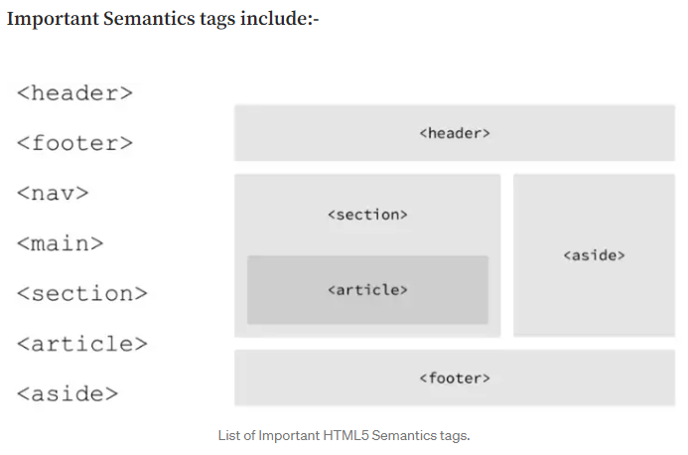

Slide 9
Semantics Tags
<header>: The header usually goes on the top, a lot of times header will contain a logo, it may have a Navigation menu, you may have a search box, etc.
<main>: The main is another important tag, which is like the main content of the page or maybe around the whole thing. ( You may write the other tags like <section>, <article>, <aside> inside the <main> tag, which generally means the main content of the page.

Slide 10
Semantics Tags
<section> : This tag defines a section in a document or a page. In the section, we can add Introduction, Chapters, News Items and Contact Information.
<aside> : The aside generally means sidebar content i.e content that is not the main focus of the page, it may Ads or Category section for the main blog section or something like that.
<footer> : The footer is generally added at the bottom of the page. It may contain copyright information, contact information, sitemap, related documents, back-to-top links, etc.

Slide 11
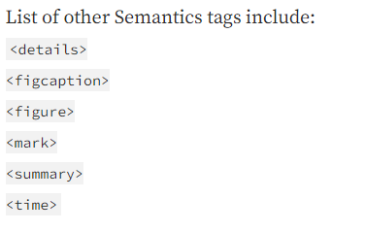

Slide 12
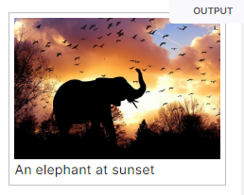
<figure> <figcaption>
<figure>
<img src="/media/cc0-images/elephant-660-480.jpg"
<figcaption>An elephant at sunset</figcaption>
</figure>

Slide 13
<dt>: The Description Term element
The <dt> HTML element specifies a term in a description or definition list, and as such must be used inside a <dl> element.
It is usually followed by a <dd> element;
however, multiple <dt> elements in a row indicate several terms that are all defined by the immediate next <dd> element.
The subsequent <dd> (Description Details) element provides the definition or other related text associated with the term specified using <dt>.

Slide 14
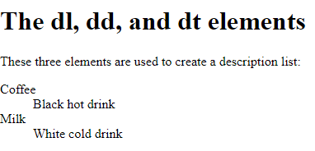
Example
<!DOCTYPE html>
<html>
<body>
<h1>The dl, dd, and dt elements</h1>
<p>These three elements are used to create a description list:</p>
<dl>
<dt>Coffee</dt>
<dd>Black hot drink</dd>
<dt>Milk</dt>
<dd>White cold drink</dd>
</dl>
</body>
</html>

Slide 15
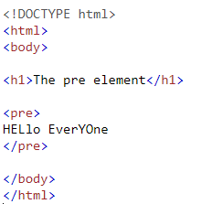

The <pre> tag defines preformatted text.
Text in a <pre> element is displayed in a fixed-width font, and the text preserves both spaces and line breaks.
The text will be displayed exactly as written in the HTML source code.

Slide 16
Table
Sometimes in our webpage or web application we need to visualize our data in tabular format.
For this, we have a Table tag in HTML which is defined by <table> tag and includes several other tags like <tr>, <td>, <th>, <caption> which are required to fill data in the table on our webpage.

Slide 17
Tables are widely used to compare two or more data pieces, in data analysis, for presenting text information and corresponding numerical data.
<table>
<tr>
<th>
<td>
<caption>

Slide 18
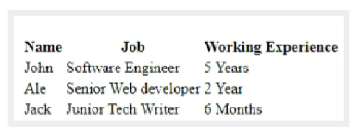
Example
<table>
<tr>
<th>Name</th>
<th>Job</th>
<th>Working Experience</th>
</tr>
<tr>
<td>John</td>
<td>Software Engineer</td>
<td>5 Years</td>
</tr>
<tr>
<td>Ale</td>
<td>Senior Web developer</td>
<td>2 Year</td>
</tr>
<tr>
<td>Jack</td>
<td>Junior Tech Writer</td>
<td>6 Months</td>
</tr>
</table>

Slide 19
Unordered list
An Unordered list <ul> tag in HTML is used to define the unordered list item in an HTML document. It contains the list items <li> element. The <ul> tag requires opening and closing tags.
Syntax:
<ul> List of items </ul>
<li> item no1 </li>

Slide 20
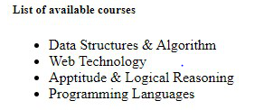
Example
<!DOCTYPE html>
<html>
<head>
<title>Unordered list</title>
</head>
<body>
<h5>List of available courses</h5>
<ul>
<li>Data Structures & Algorithm</li>
<li>Web Technology</li>
<li>Aptitude & Logical Reasoning</li>
<li>Programming Languages</li>
</ul>
</body>
</html>

Slide 21
<summary> and <details>
The <summary> tag in HTML is used to define a summary for the <details> element.
The <summary> element is used along with the <details> element and provides a summary visible to the user.
When the summary is clicked by the user, the content placed inside the <details> element becomes visible which was previously hidden.
The <summary> tag was added in HTML 5.
The <summary> tag requires both starting and ending tag.
Note: The <summary> element should be the first child element of the <details> element.

Slide 22

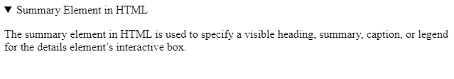
Syntax:
<summary> Content </summary>
<html>
<head>
</head>
<body>
<details>
<summary>Summary Element in HTML</summary>
<p>The summary element in HTML is used to specify a visible heading, summary, caption, or legend for the details element’s interactive box.</p>
</details>
</body>
</html>

Slide 23
Hyperlink <a> tag
<a>: The Anchor element
The <a> HTML element (or anchor element), with its href attribute, creates a hyperlink to web pages, files, email addresses, locations in the same page, or anything else a URL can address.
Content within each <a> should indicate the link's destination. If the href attribute is present, pressing the enter key while focused on the <a> element will activate it.

Slide 24
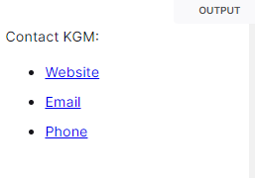
Example
<p>Contact KGM:</p>
<ul>
<li><a href="https://www.kg.com">Website</a></li>
<li><a href="aa@kgm.com">Email</a></li>
<li><a href="tel:896677888">Phone</a></li>
</ul>

Slide 25
New Features in HTML 5
HTML 5 is an independent markup language and is no longer a part of SGML.
It can be use on desktop as well as mobile devices like tablets, smartphones.
A web page is treated as a web document having a specific structure with new tags like <header>, <footer>, <article>, <sections>,<aside>, <figure>.
A web page can be made more interactive by adding audio and video file by using new tags <audio>, <video>.
It has <menus>, <commands>, <details>, <datagrid> to help a web application developer with the designing of a dynamic webpage.
It has new <canvas> tag for drawing graphics. It has several methods to draw paths, boxes, circles, text, and adding images. We must use JavaScript to support this tag in a web page.

Slide 26

Workout
Create a Html file with My Success Story as title.
Create a Html file with the paragraph about your studies journey as a body with “My Qualification” as heading 4.
3. Create a html file with pre tag for your college details with heading 5 as “ My College”.
4. Create a Html file with table having sno, family member, title and age as table heading.

Slide 27
Workout
Create a Html file with atleast three rows inserted into the above table.
6. Create a Html file with unordered list of your hobbies. And make hobbies as heading.
7. Create a Html file with Success Story as Summary and Details inserted within that Summary.
8. Create a Html file with Description List of your atleast 5 Friends with their qualities.

Slide 28
Complete the
Week 2 Exercises
on Coursera

Slide 29



Thank You

